Slide 1
Guessing Number Game
Python - mini project
Name of the students - Arpita sarda
En.no- 197051
Komal sasane
En.no.- 197052
Branch- Information Technology (2nd year)

Slide 2
Introduction
* A guessing number game is a simple guessing game whre a user supposed to guess a number between 0 and N in a maximum of 10 attempts.
The game will end after 10 attempts and if the player failed to guess the number,and then he loses the game.

Slide 3
Which python concepts are covered ?
IF ELSE
WHILE LOOP
RANDOM FUNCTION
BREAK STATEMENTS

Slide 4
Guessing game
Guess a number 0 to 100.
The guess closest to 2/3 the average number wins a prize.
Ties will be broken randomly .
Please write your name and your guess on the piece og paper and turn it in to me.
Don't let others see your guess!

Slide 5
Guessing game
Guess a number 0 to 100.
the guess closest to 2/3 average number wins a prize.
Your average was...
Wharton average 40
Caltech UG average was 30(10% at 0)
Economics phds 25
CEO average also 40.
What would we expect if everyone is rational and thinks everyone else is rational?
Now repeat this!

Slide 6
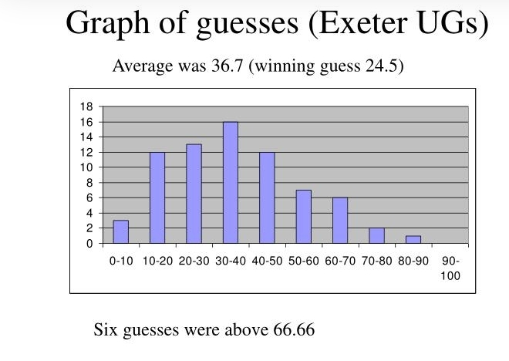

Slide 7
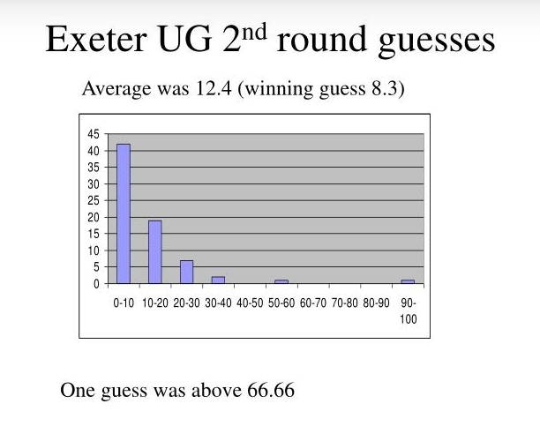

Slide 8
Program
import random
import math
# Taking Inputs
lower = int(input("Enter Lower bound:- "))
# Taking Inputs
upper = int(input("Enter Upper bound:- ")
#generating random number between
# the lower and upper
x = random.randint(lower, upper)
print("\n\tYou've only ",
round(math.log(upper - lower + 1, 2)),
" chances to guess the integer!\n")
# Initializing the number of guesses.
count = 0
# for calculation of minimum number of
# guesses depends upon range
while count < math.log(upper - lower + 1, 2):
count += 1

Slide 9
taking guessing number as input guess = int(input("Guess a number:- ")) #taking guessing number as input Guess = int (input("guess number:-")) # Condition testing if x == guess: print("Congratulations you did it in ", count, " try") # Once guessed, loop will break break elif x > guess: print("You guessed too small!") elif x < guess: print("You Guessed too high!")

Slide 10
If Guessing is more than required guesses, # shows this output. if count >= math.log(upper - lower + 1, 2): print("\nThe number is %d" % x) print("\tBetter Luck Next time!") ****** Output : Enter Lower bound :- 1 Enter Upper bound :- 188 You' ve only 7 chances to guess the Integer! Guess a number :- 50 You guessed to small! Guess a number :- 75 You guessed to high!

Slide 11
Guess a number :- 62
You guessed to high!
Guess a number :- 56
You guessed to high!
Guess a number :- 53
You guessed to small!
Guess a number :- 54
Congratulations you did it in 6 try
Process finished with exit code 0
******

Slide 12
Thank you

